Slide 1

North Western University, Khulna
1
Welcome to our presentation
On Computer Network
Course Title: Computer Networking Sessional
Course Code: CSE-3304
December 24, 2022

Slide 2



Team Name :
2
MSM
Details of Team Members :
Md Abu Siddik
Student Id: 20201131010
Department of CSE
North Western University
Khulna, Bangladesh
Mrittika Banerjee
Student Id: 20201140010
Department of CSE
North Western University
Khulna, Bangladesh
Tahmina Akter
Student Id: 20201148010
Department of CSE
North Western University
Khulna, Bangladesh

Slide 3
3
Overview
Introduction
Objectives
Necessary software
Bird’s eye view
Project view
Scan by zenmap
Network tropology
Note in excel sheet
Coding
Output
Dependencies

Slide 4
4
Introduction
For providing visual network mapping
For predict the performance of wireless communication network
Scan and check the network details
Check the topology graph
Implement a virtual view of the network by code using this data
Able to see if there’s any problem or fault in a wireless network
Help the anyone to detect the data drop or buffer in a network

Slide 5
5
Objective
1 Domain
4 hosting network
Zenmap
MS-Excel
Ubuntu
Xming
NS2
Nam

Slide 6
6
Domain & Hosting
Domain : www.w3schools.com
Hosting : There are 4 hostings
Speednet
Banglalink
Grameenphone
Gazilink

Slide 7
7
Necessary software
Zenmap : Zenmap is the official GUI(Graphical User Interface) for Nmap Security Scanner. Nmap means Network Mapper. It is a free and open source utility for network discovery and security auditing.
Xming : This is a display server for windows operation system. It allows one to use Linux graphical applications remotely.
Ubuntu : Ubuntu is not a software. This is a distro of linux operating system. For useing NS2 and nam editor we have to use linux operating system.
NS2 : The full meaning of NS2 is Network Simulator version 2. Ns is a discrete event simulator targeted at
networking research.
Nam : This is a Tcl/TK based animation tool for viewing network simulation traces and real world packet
traces.

Slide 8
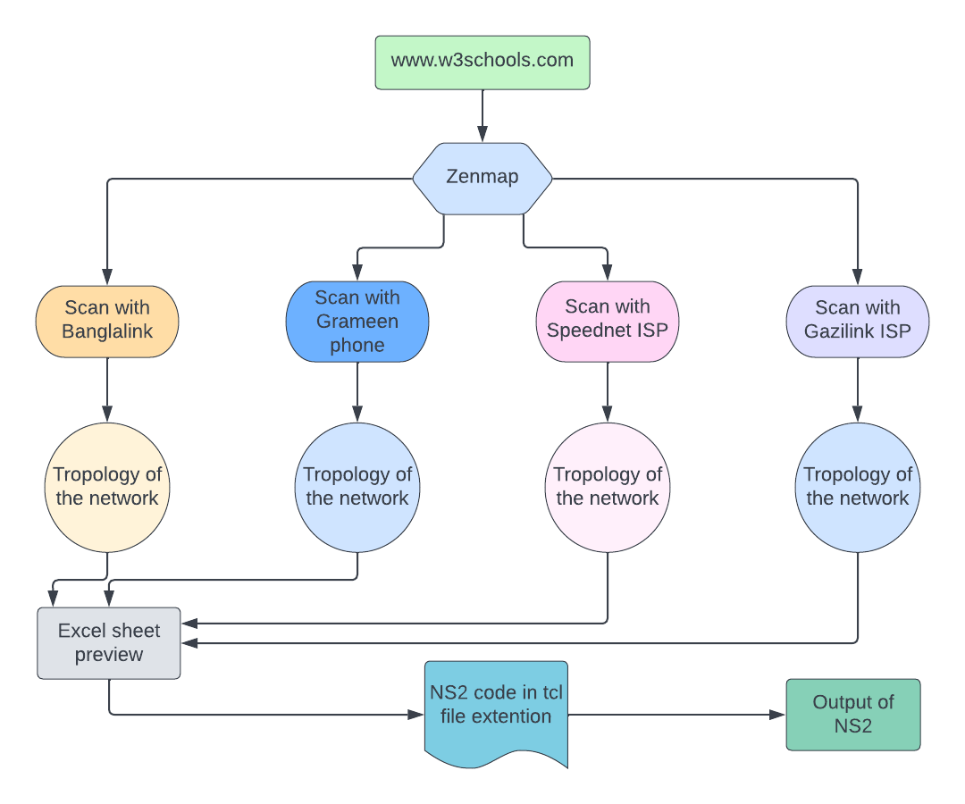
8
Bird’s eye view

Slide 9
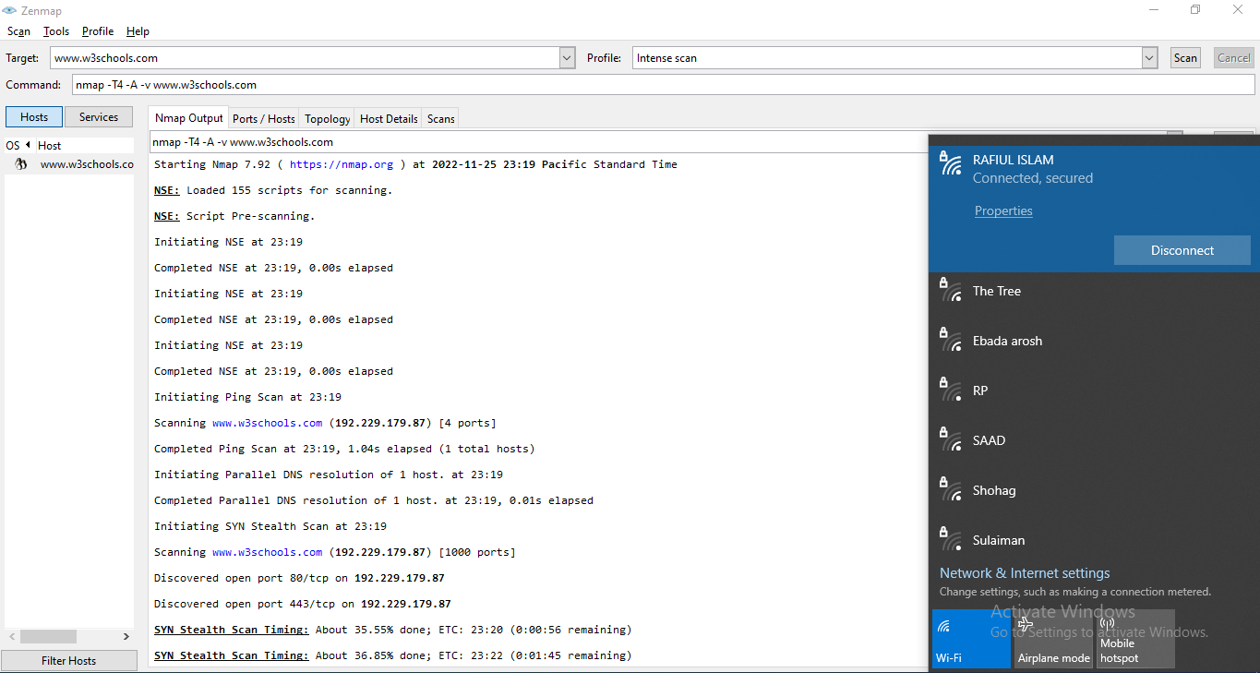

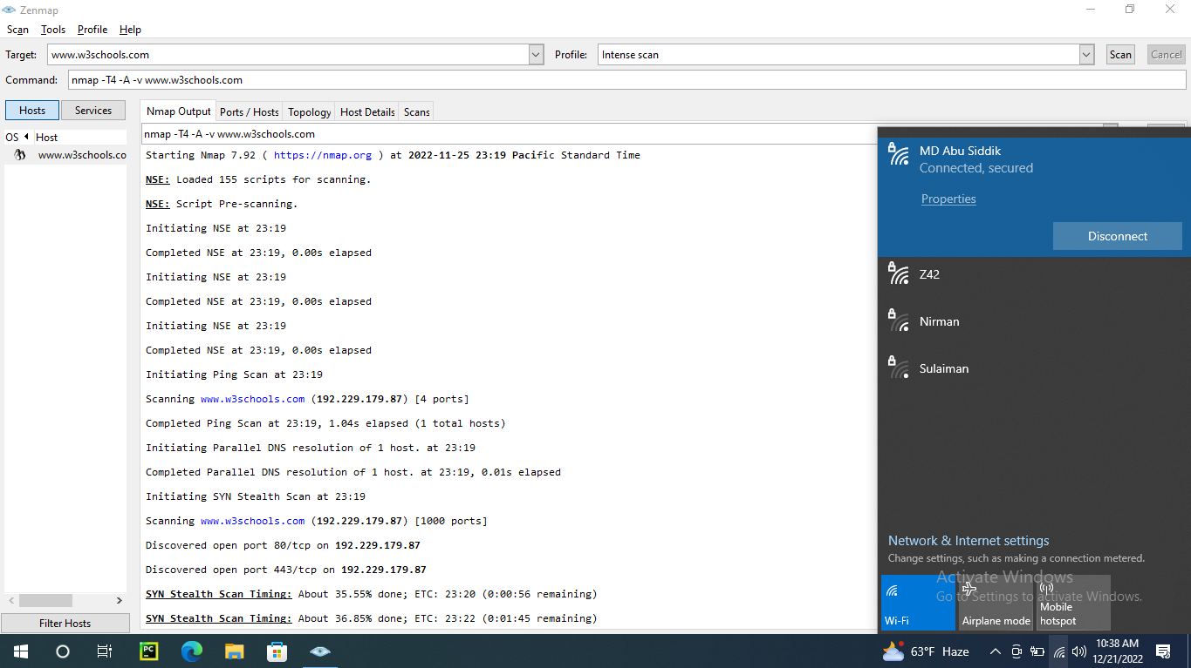
9
Scan by zenmap
Scan the domain(www.w3schools.com) by zenmap connecting 4 different hosting network.

Slide 10
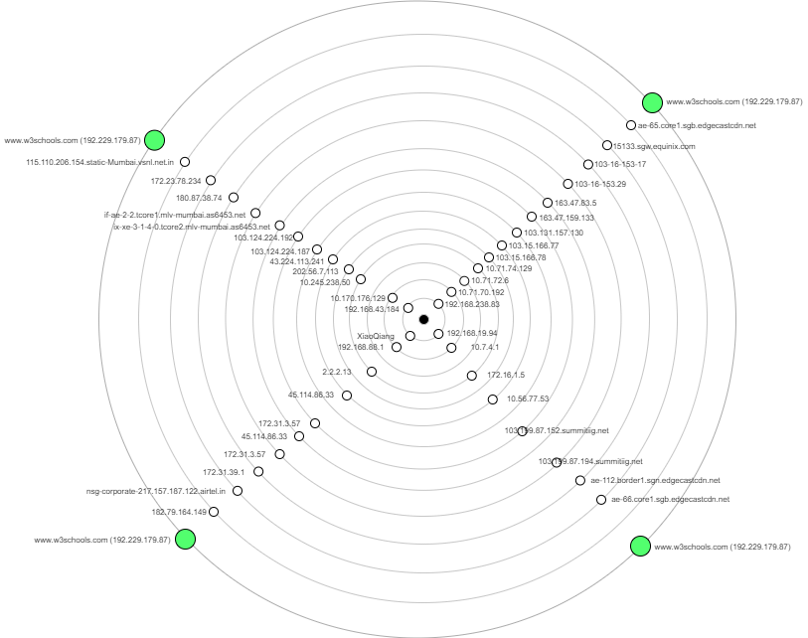
10
Network tropology
Fig : Network topology

Slide 11
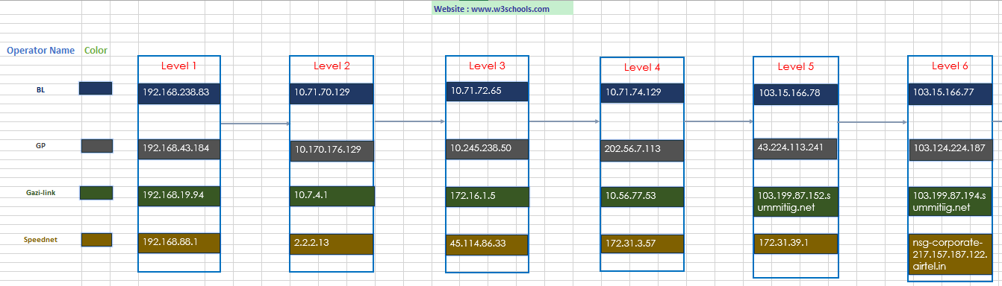
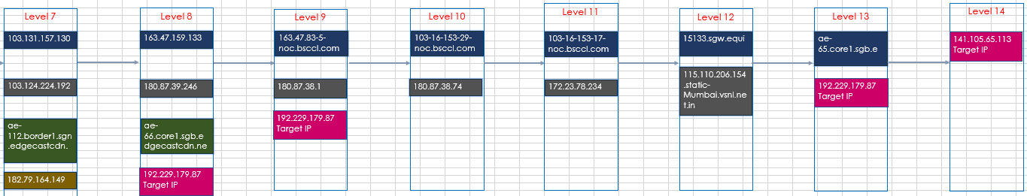
11
Note in excel sheet

Slide 12
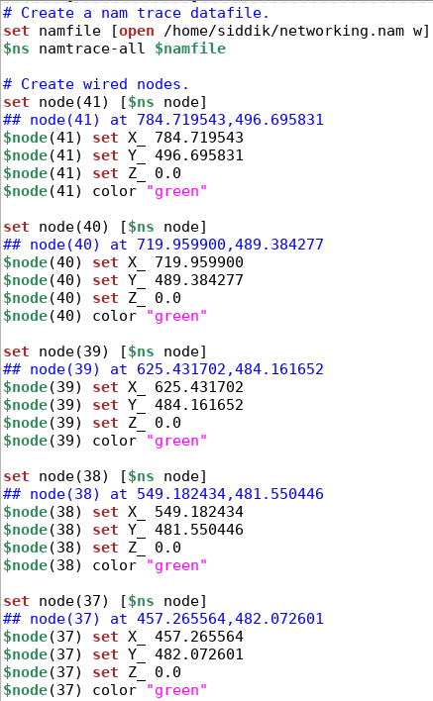
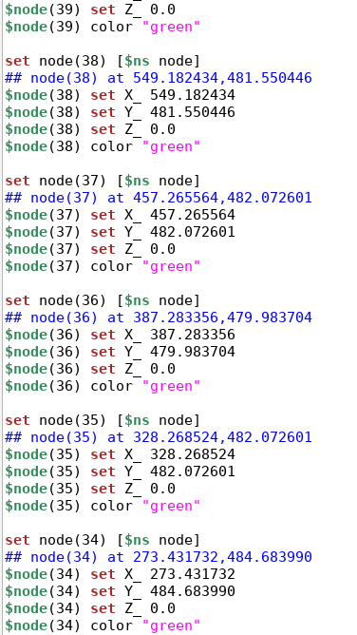
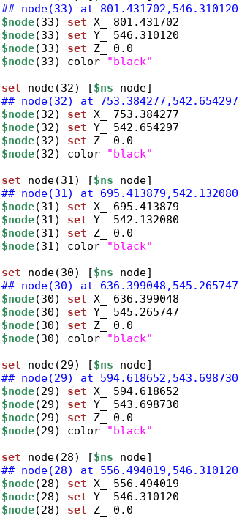
12
Coding demo

Slide 13
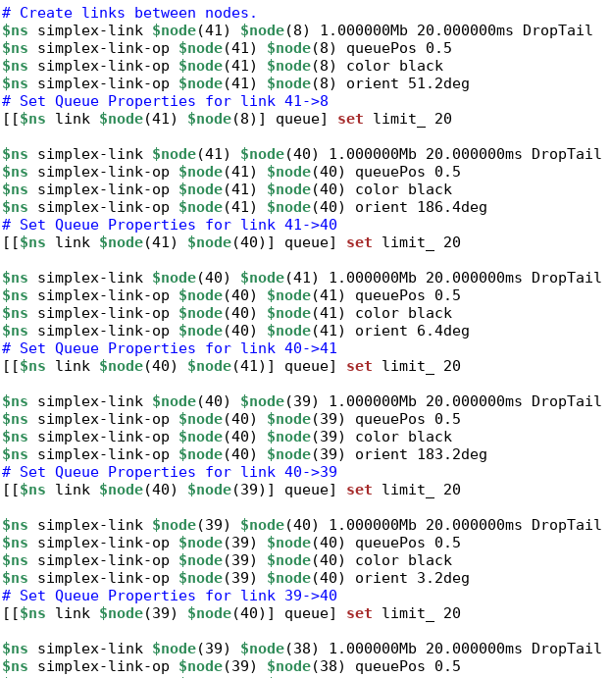
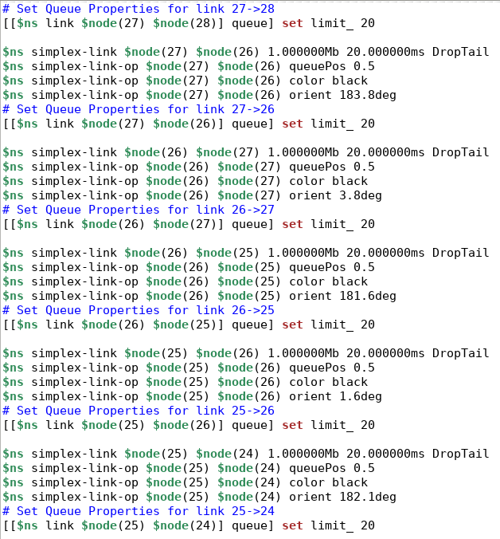
13
Coding demo

Slide 14
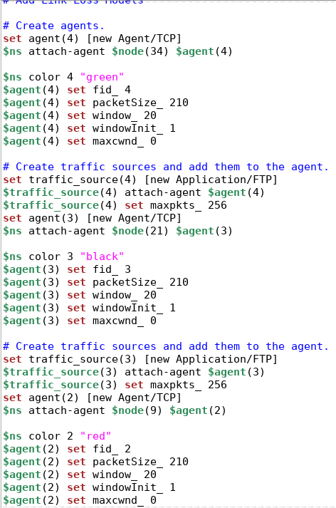
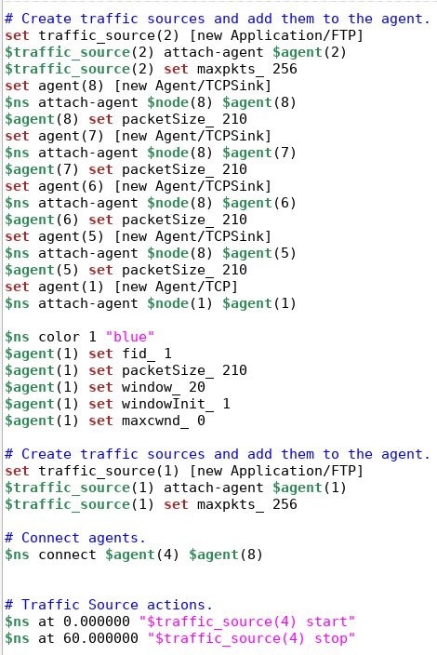
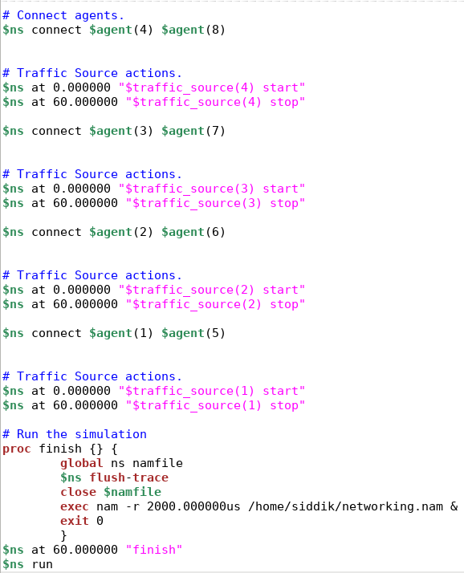
14
Coding demo

Slide 15
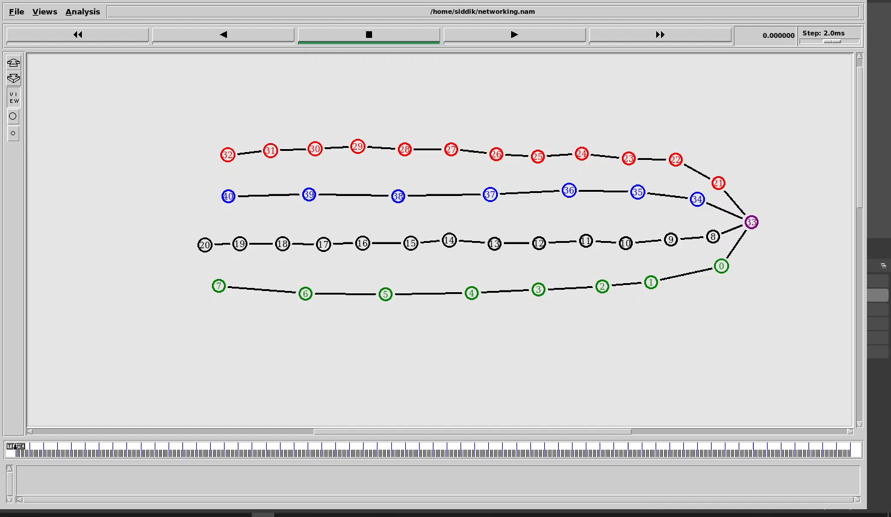
15
Output

Slide 16
16
Dependency
NS2 and NAM editor is not available for windows OS. It’s a large problem for windows users.
Ubuntu is installed virtually. Virtual Ubuntu is not as better as original Ubuntu.
Ubuntu installed by WSL and then install NS2, NAM was little challenging. This process was not so easy for everyone.
Many works of the software is command based. So all of the commands must have to memorized.

Slide 17
Thank You
Any Question?

